Slide 1
UPH Simulation state 23.07
With automation Line Layout

Slide 2
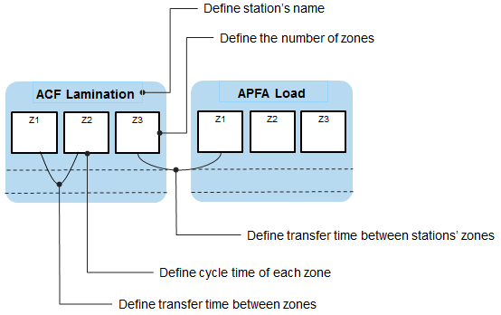
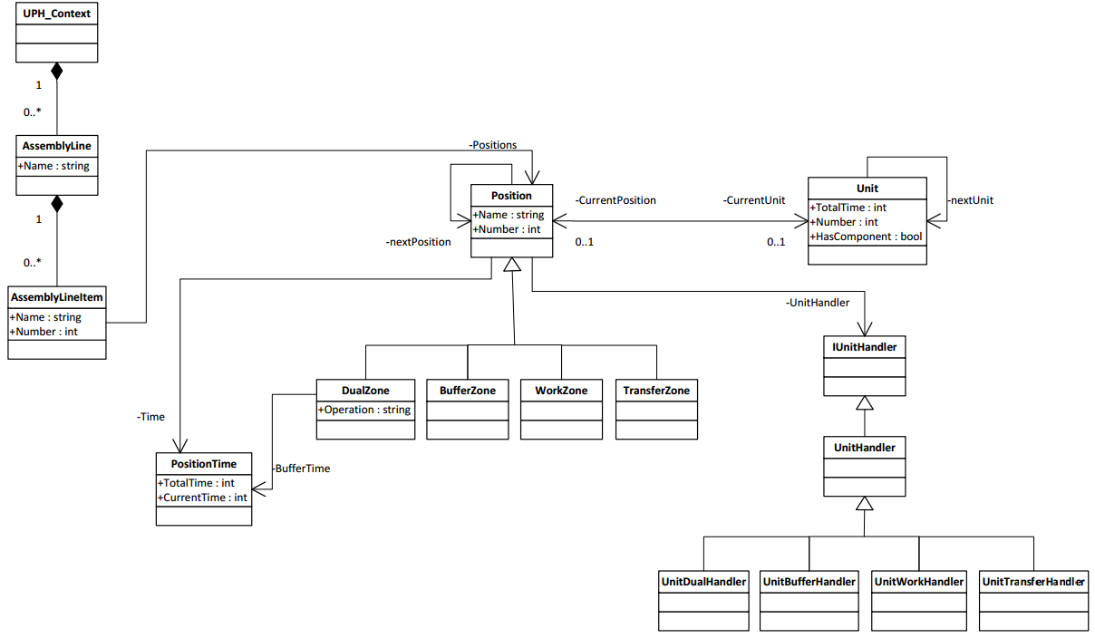
Architecture

Slide 3
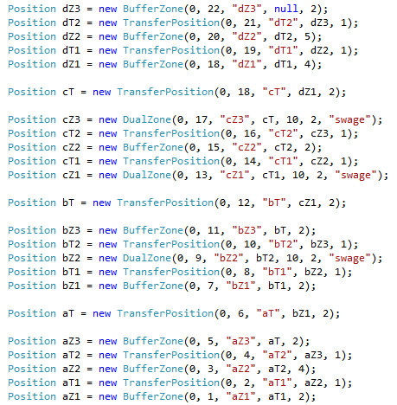
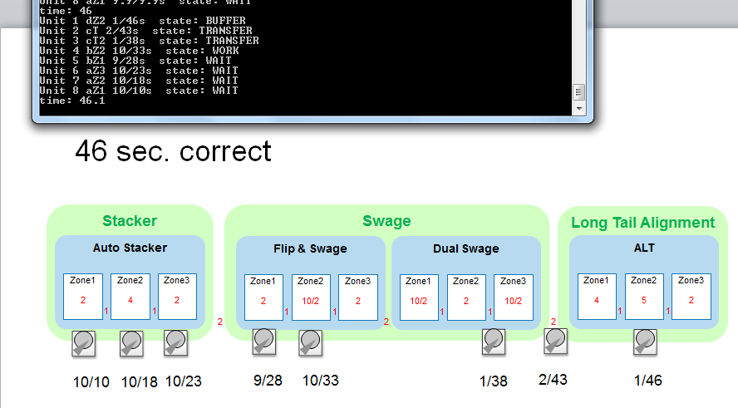
Algorithm

Slide 4
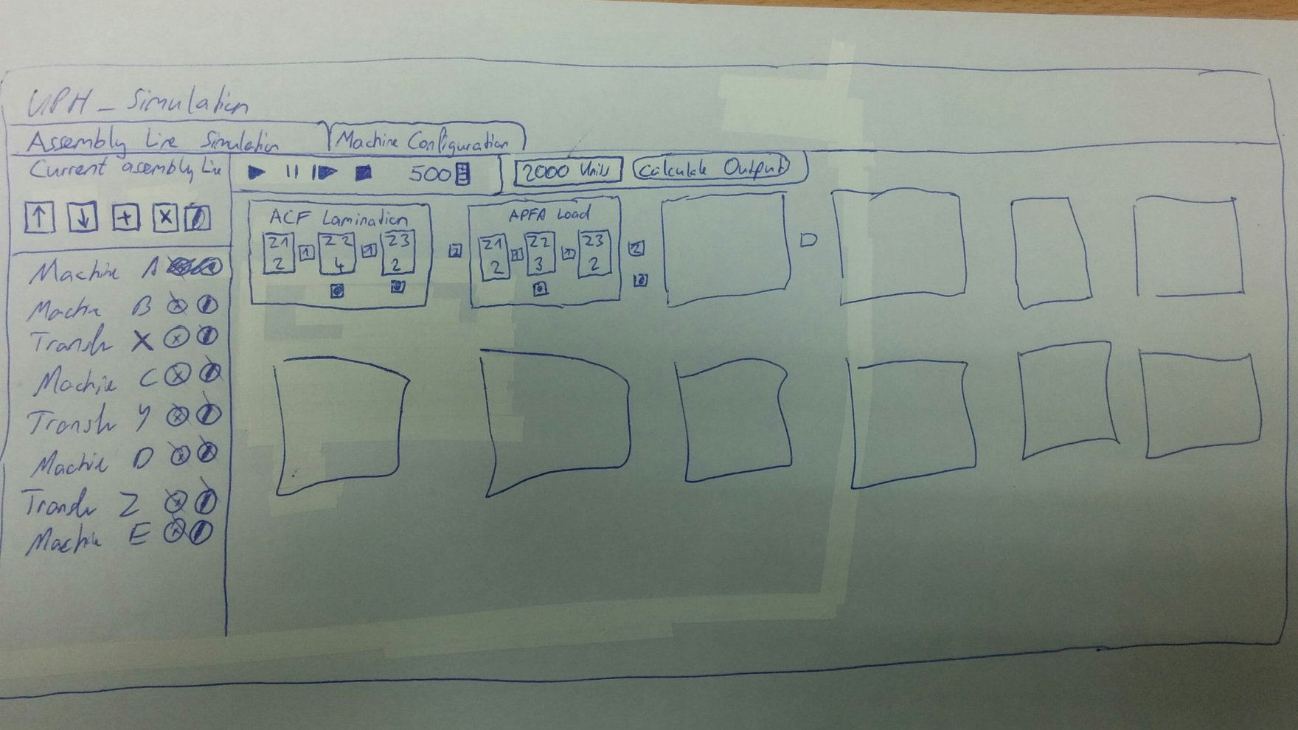
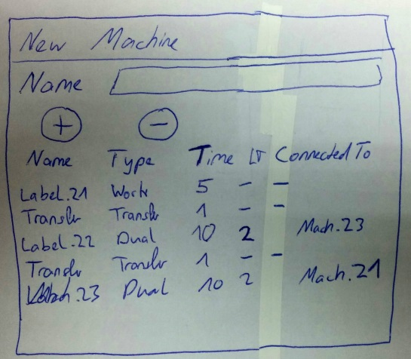
UI Draft

Slide 5
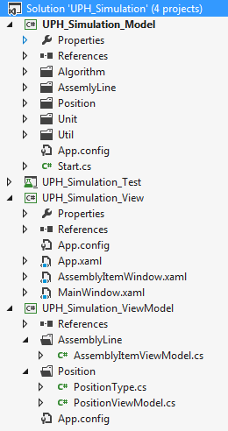
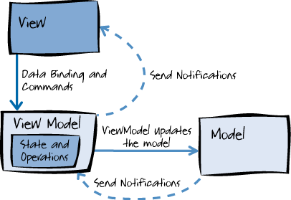
UI Technology
WPF MVVM

Slide 6
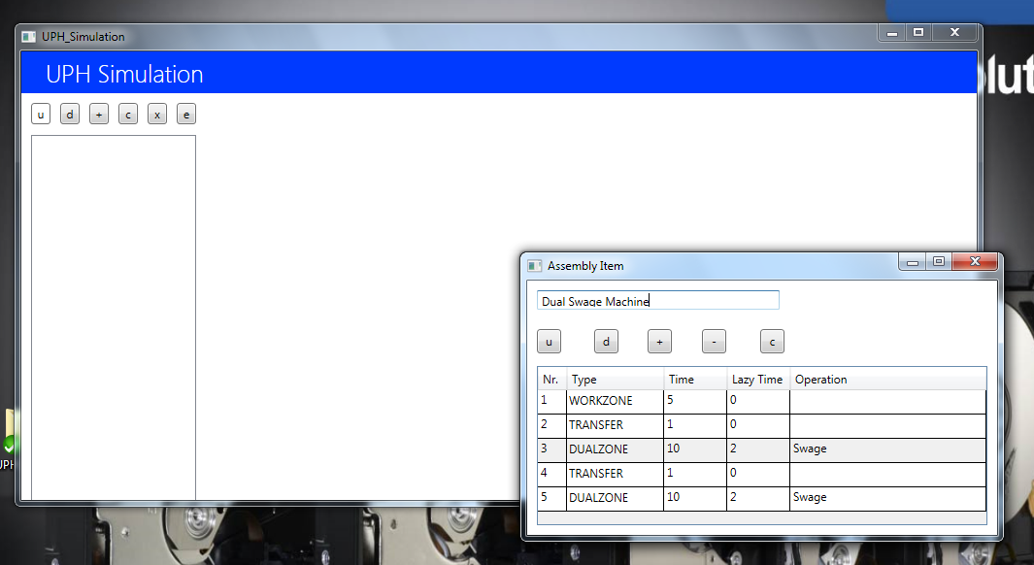
UI Current State

Slide 7
Future requirements
User interface specification
Load and save data (xml files)
Precision of timesteps
Improve MVVM architecture skills

